Slide 1
Air Pollution Monitoring
CROWd-Sourced AQI Calculation
Presented By:
M Hammad Sarwar
Awais Asghar
Ashar Javid

Slide 2
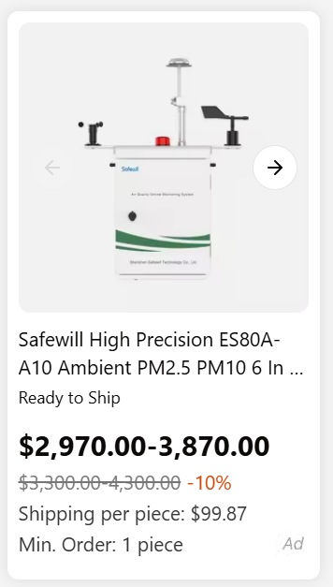
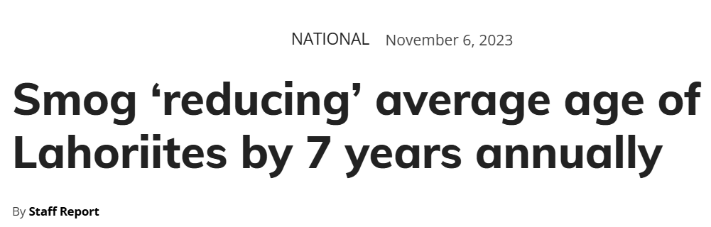
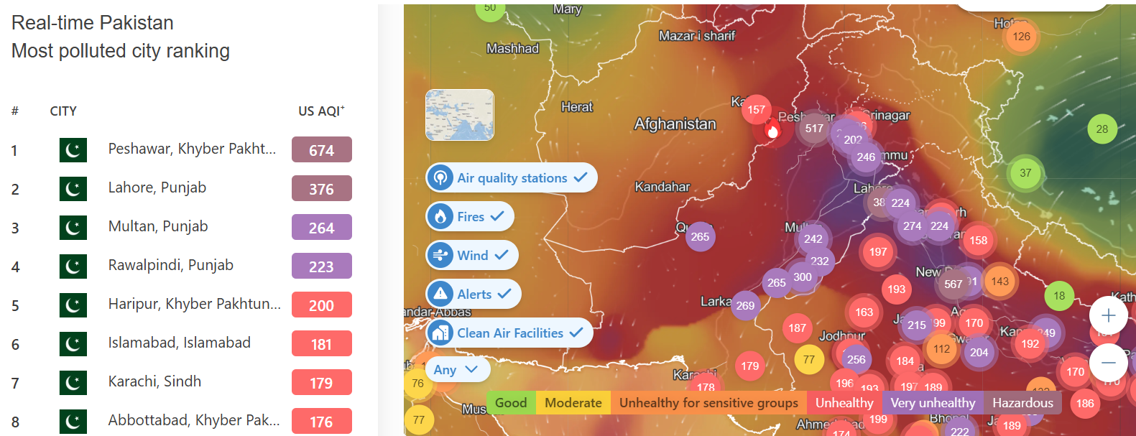
Air Pollution Monitoring
AQI Calculation

Slide 3

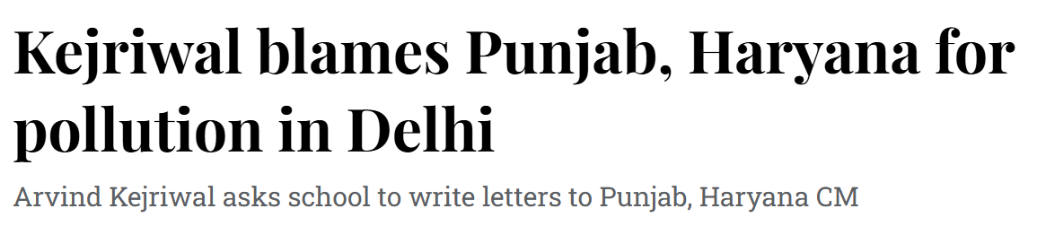
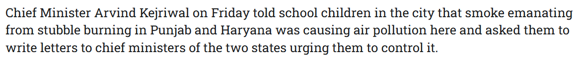
Whose pollution is it?

Slide 4
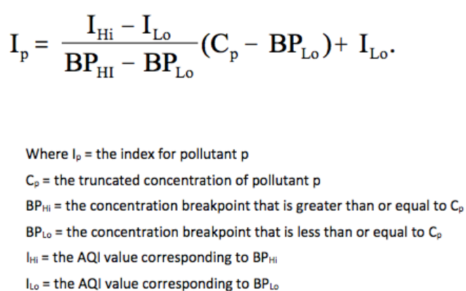
WHAT is an aqi index MOnitor?
A system used to measure and report the quality of air in a specific location.
It provides real-time data about the concentration of pollutants in the air and the associated health effects.

Slide 5
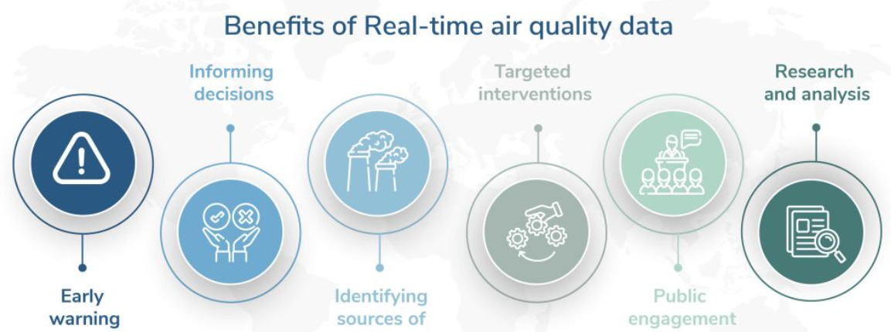
WHY Crowdsourced AQI INdex Monitoring?
State-owned Data Collection
Custom Calibration
Air quality forecasting
Research on air pollution
Monitoring compliance with regulations for city zones

Slide 6

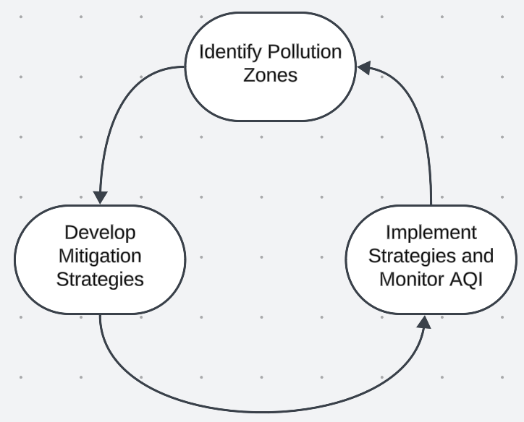
Proposed Methodology
Area-Based AQI Monitor Network
Standardized Measuring Devices

Slide 7

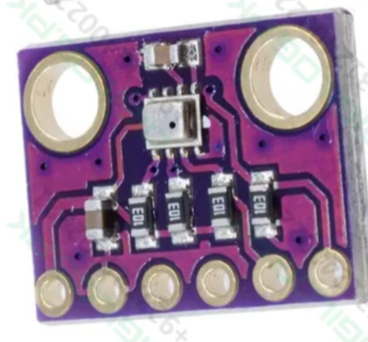
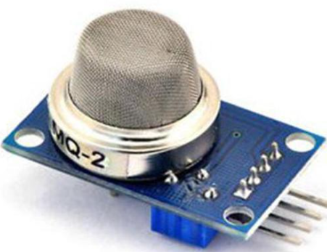
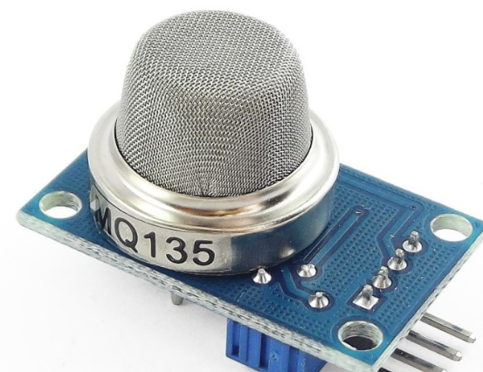
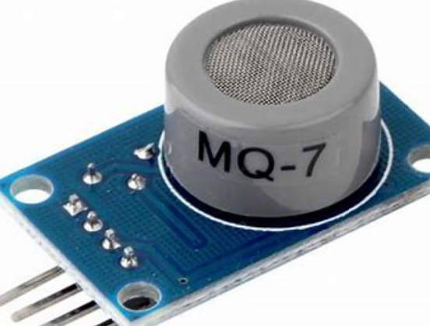
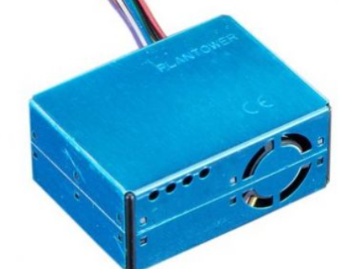
Components
 | Sensor | Measurement | Pin/Port | Description
 | DHT 22 | Temperature & Humidity | D8 | Measures ambient temperature and relative humidity.
 | BMP 280 | Temperature, Pressure & Altitude | I2C (default 0x76) | Measures temperature, atmospheric pressure, and calculates altitude.
 | MQ-2 | LPG, Propane, Alcohol, H2 | A0 | Detects combustible gases and smoke.
 | MQ-135 | CO2, NH4, Toluene | A1 | Detects air quality-related gases (e.g., CO2, ammonia, and volatile organics).
 | MQ-7 | CO & CH4 | A2 | Detects carbon monoxide and methane.
 | PMS5003 | PM2.5, PM10 & other particulate matter levels | Serial Pins 7,10 | Measures particulate matter in the air at different size ranges.
Arduino UNO
Sensors

Slide 8
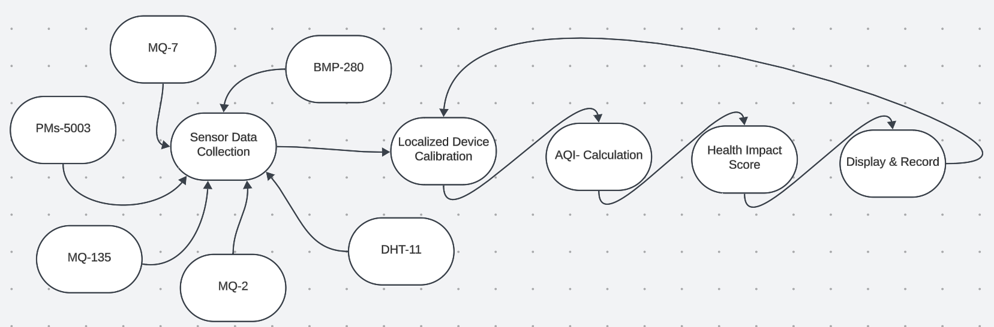
Block Diagram

Slide 9
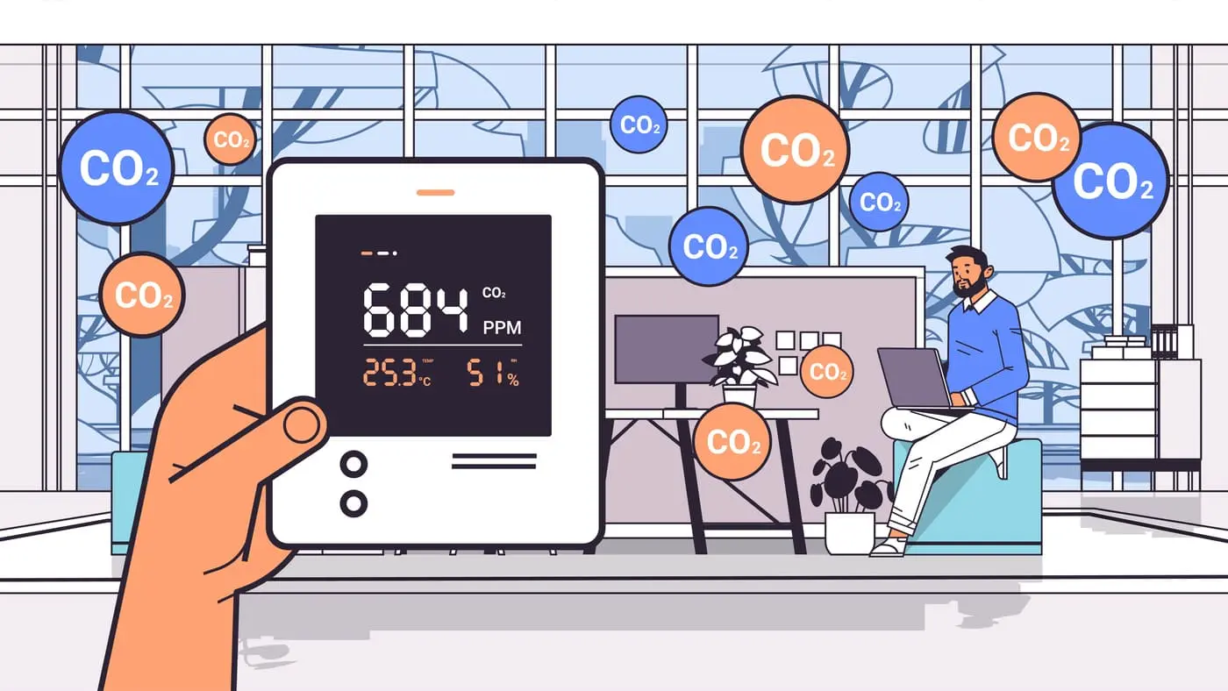
SELECTING VISUAL AIDS
ENHANCING YOUR PRESENTATION

Slide 10
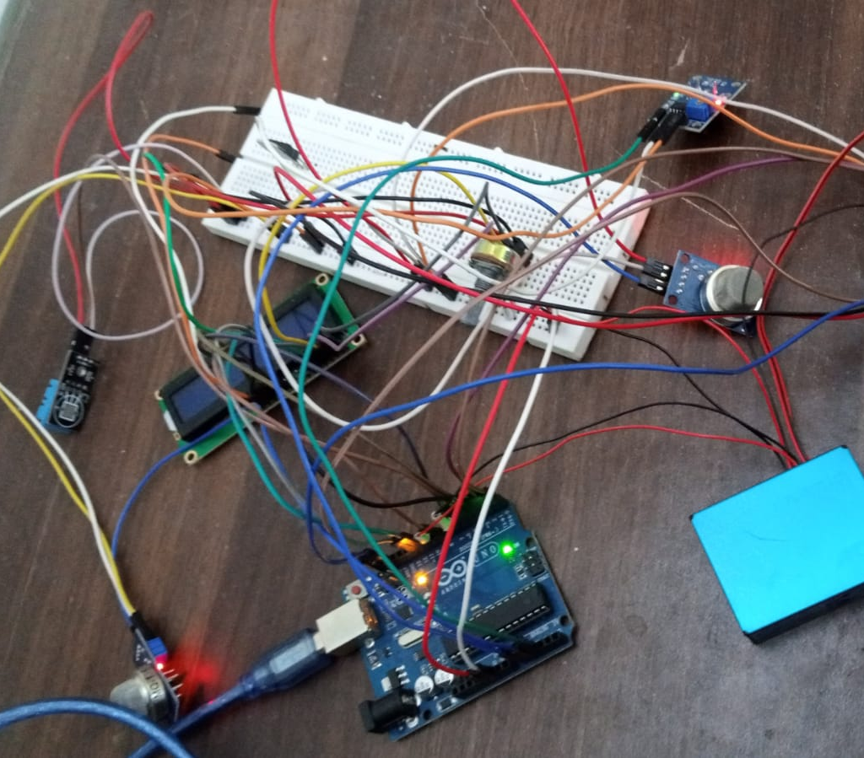
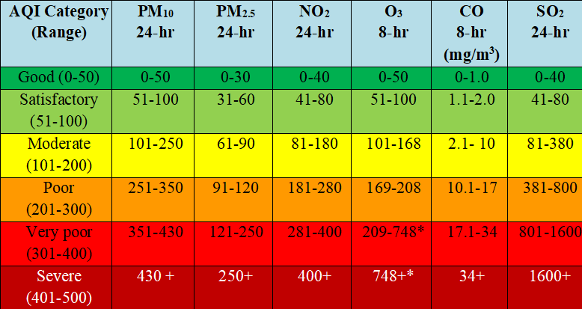

Methodology (Part I: Hardware)

Slide 11

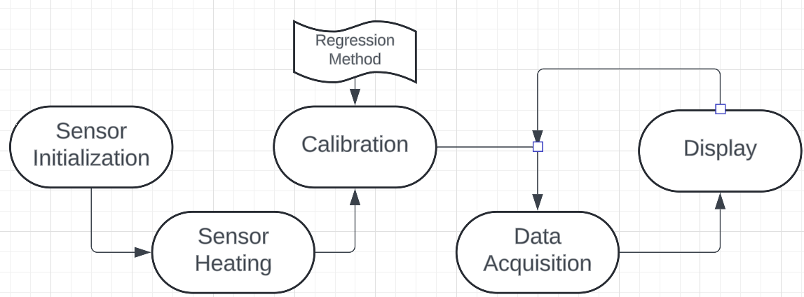
Methodology (Part II: Software)

Slide 12
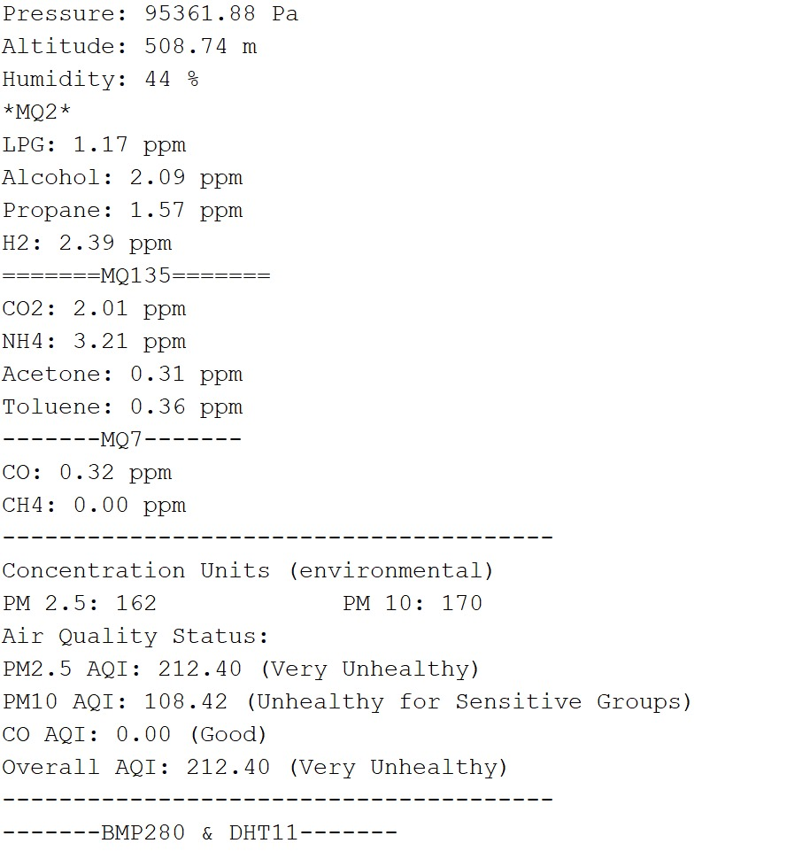
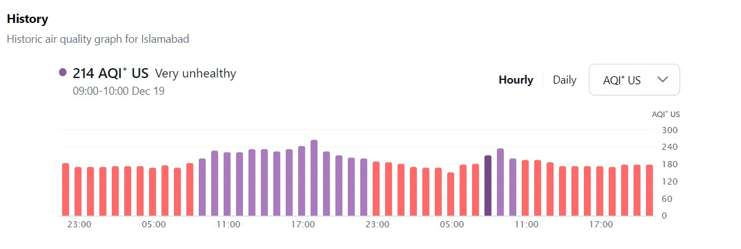
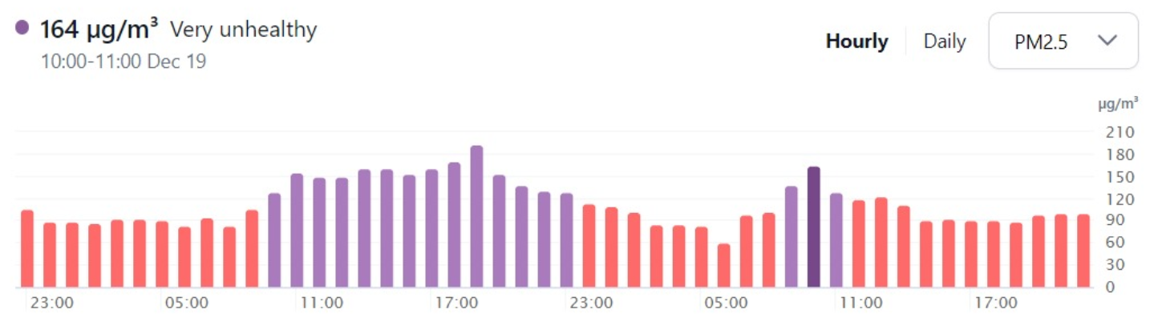
Results and Data Analysis
At 10:42 pm: (Location→Islamabad)
19th December,2024:
Our System Values:
IQ AIR:

Slide 13

Future Projections
Well, We really love ML models!!! And Our Belief is that every system can be improvised using them.
The Next Step is: LSTM-based future AQI prediction
Current Limiting Factor?
Crowdsourced-AQI Monitoring
Long-term local data collection

Slide 14
THANK YOU

